Slide 1

PREDICTION
Thanks to Mentor.
Mr. A J Sanchez
By,
Sheema Murugesh Babu

Slide 2
Introduction
A retail company ABC Private Limited wants to understand the customer purchase behavior (specifically, purchase amount) against various products of different categories. They have shared purchase summary of various customers for selected high-volume products from the last month.
They want to build a model to predict the purchase amount of customer against various products which will help them to create personalized offers for customers against different products.

Slide 3
Problem statement
Setting the optimum price of a product is often a challenging problem for retailers, especially during a sale like the ‘Black Friday’.
The challenge here is to predict purchase prices of various products purchased by customers based on historical purchase patterns.
The data contains features like age, gender, marital status, categories of products purchased, city demographics etc.

Slide 4
Dataset information
Dataset was available in Kaggle’s website and was saved into local as ‘BlackFriday.csv’
The data available in the data set has below columns
Variable | Definition
User_ID | User ID
Product_ID | Product ID
Gender | Sex of User
Age | Age in bins
Occupation | Occupation (Masked)
City_Category | Category of the City (A, B, C)
Stay_In_Current_City_Years | Number of years stay in current city
Marital_Status | Marital Status
Product_Category_1 | Product Category (Masked)
Product_Category_2 | Product may belong to another category (Also Masked)
Product_Category_3 | Product may belong to another category (Also Masked)
Purchase | Purchase Amount

Slide 5
Data wrangling steps
Used pandas read_csv module to import the data set.
Upon executing the read_csv function using the info() method, the csv file has 537577 entries and 12 columns with different formats of data.
Product categories 2 and 3 had missing values (or NaN’s) which were replaced with ‘0’.
Pickled the notebook (dw_bf.pickle) for future reference.

Slide 6
Data Storytelling
The questions I considered are as follows.
Q) Who is more likely to spend more in a black Friday sale?
1) Men or Women.
2) Married or Un-Married individuals
3) Old Residents or new residents/visitors
Q) Which type of products are more likely to be sold in a sale like black Friday?
Q) Which type of products are more frequently purchased among men and women?

Slide 7
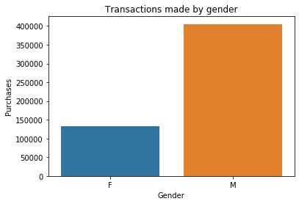
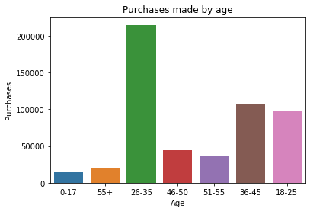
Transactions made by “gender”
Purchases made by “age”

Slide 8
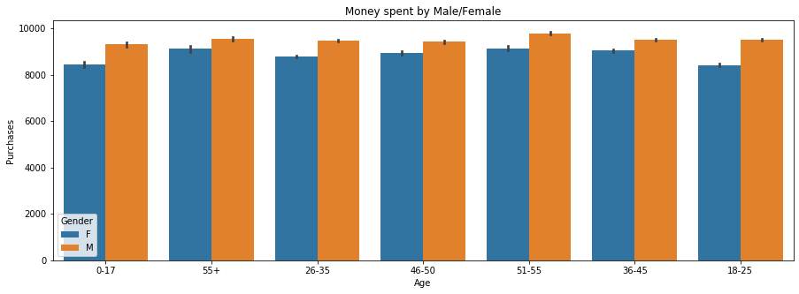
Money spent by “Male/Female”

Slide 9
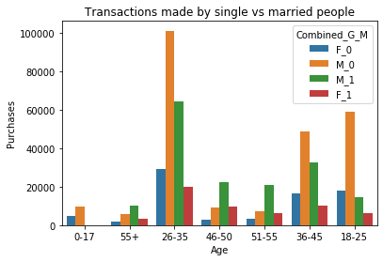
Transactions made by single vs married people

Slide 10
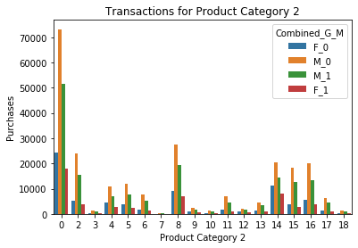
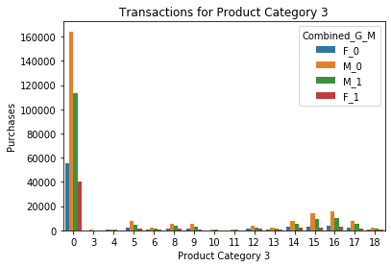
Transactions for Product Category 2 and Product Category 3

Slide 11
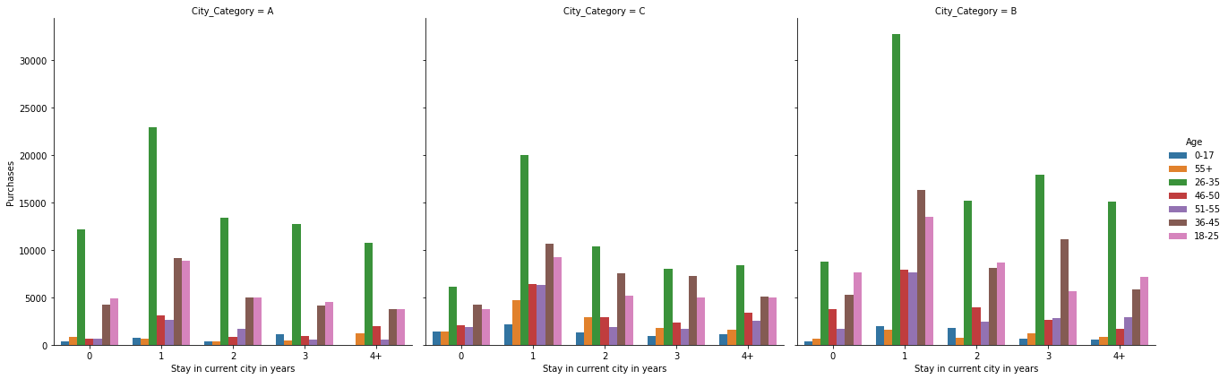
Transactions for the Stay in current city in years

Slide 12
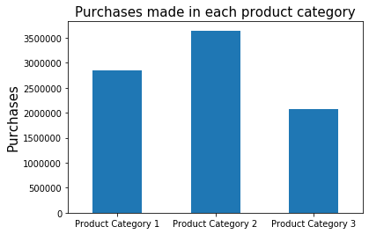
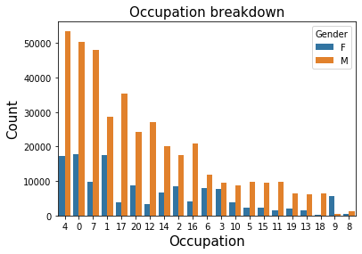
Purchases made in each product category
Occupation breakdown

Slide 13
Hypothesis Testing
Interpretation
The null hypothesis is that the means of the samples are equal. Rejecting the null hypothesis would imply that at least one of the means is different. The decision to reject the null hypothesis and accept the alternative hypothesis is based on the significance level of the test (α) and the probability of observing the effect given that the null hypothesis is true (p-value). If p-value ≤ α the null hypothesis is ruled out. We typically use a value of α=0.05, which corresponds to 95% confidence.

Slide 14
Inferential Statistics
One-way ANOVA test using statsmodels is used. Also, Tukey’s HSD Post-Hoc Comparison is performed, with the construction of ANOVA tables.
For categorical variables, the R-squared and the Adj. R-squared is low i.e. 0.009, p-value < 0.05.
The p-value < α. i.e., < 0.05. Hence we reject the null hypothesis.
For numerical variables, the R-squared and the Adj. R-squared is high i.e. 0.130, p-value < 0.05.
The p-value < α. i.e., Hence we reject the null hypothesis.

Slide 15
Baseline modelling
Used one-hot encoding using the get_dummies method of pandas to create dummy features for all the categorical data.
Used Train Test Split method to split my data set into “X”, “y”.
The variable ‘X’ contains all columns except the target variable and the variable ‘y’ contains only the target variable.
The training set is 75% of our total data and training set is 25% of the data.

Slide 16
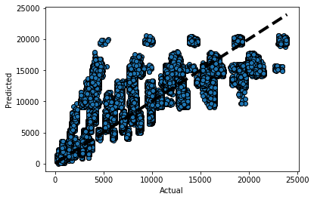
Baseline modelling – Linear Regression
Instantiated a Linear Regression object, fitted on the Training set, predicted on the test set and calculated different scoring metrics to measure the performance of the model.
The Linear regression’s R2 score for the test set was 63.69%.
Predicted v/s Actual plot

Slide 17
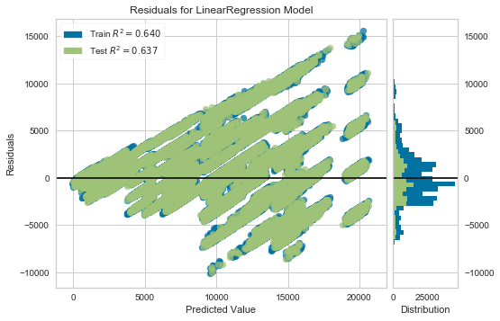
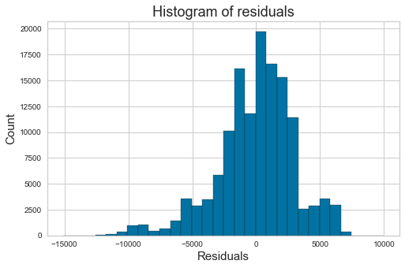
Residuals for LR Model
Histogram of Residuals

Slide 18
Extended modelling
Performed Ridge, Lasso and Random Forest regression.
Carried out the same initial steps as the linear regression model.
Algorithms | Root mean squared error | R2 score (Test Set)
Ridge Regression | NIL | Low alpha = 63.69% High alpha = 63.67%
Lasso Regression | NIL | alpha=1 - 63.65% alpha=0.01 - 63.69% alpha=0.0001 - 63.69%
Random Forest Regression | 3048.62 | 62.64%

Slide 19
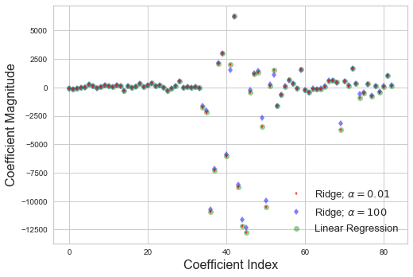
Coefficient index vs the coefficient magnitude
Ridge Regression

Slide 20
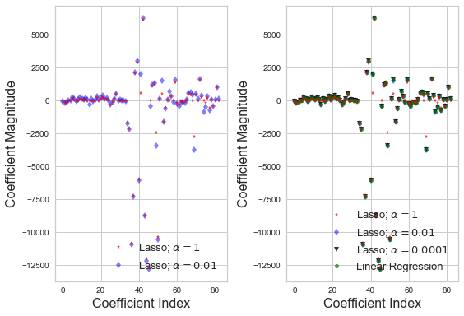
Coefficient index vs the coefficient magnitude
Lasso Regression

Slide 21
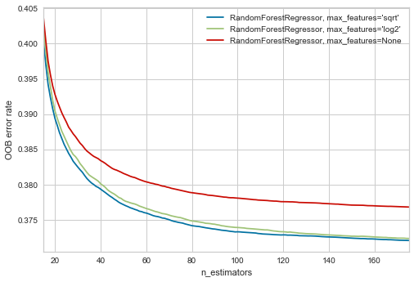
Random forest Regression
Calculated the best max feature and the n-estimators using a plot of OOB error rate vs n-estimators.
max_features = ‘sqrt’
n_estimators=160

Slide 22
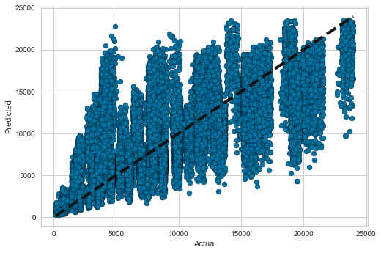
Random forest Regression – Contd.
Using the max_features and n-estimators, fitted it on the train set, predicted on the test set and calculated different scoring metrics to measure the performance of the model.
The Random Forest Regression’s R2 score for the test set was 62.64% which is less than the Linear Regression’s score of 63.69%.
Predicted v/s Actual plot

Slide 23
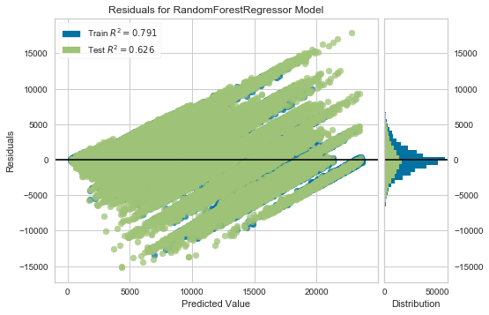
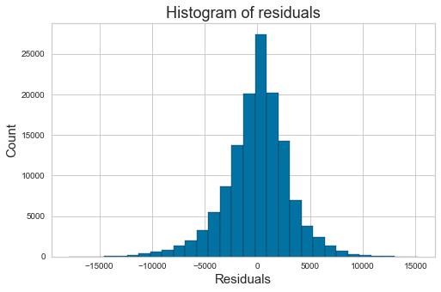
Residuals for RFR Model
Histogram of Residuals

Slide 24
Findings
Algorithms | Root mean squared error | R2 score (Test Set)
Linear Regression | 3005.25 | 63.69%
Ridge Regression | NIL | Low alpha = 63.69% High alpha = 63.67%
Lasso Regression | NIL | alpha=1 - 63.65% alpha=0.01 - 63.69% alpha=0.0001 - 63.69%
Random Forest Regression | 3048.62 | 62.64%

Slide 25
Conclusions and Future Work
Previously, we jotted down the R2 scores of all the four machine learning models. We can conclude that Linear Regression Model performed better.
Many different approaches than the ones above can also be used in the Black Friday sales prediction. Going forward I would like to try out some different algorithms. One such algorithm which come to my mind is the XGBoost model.

Slide 26
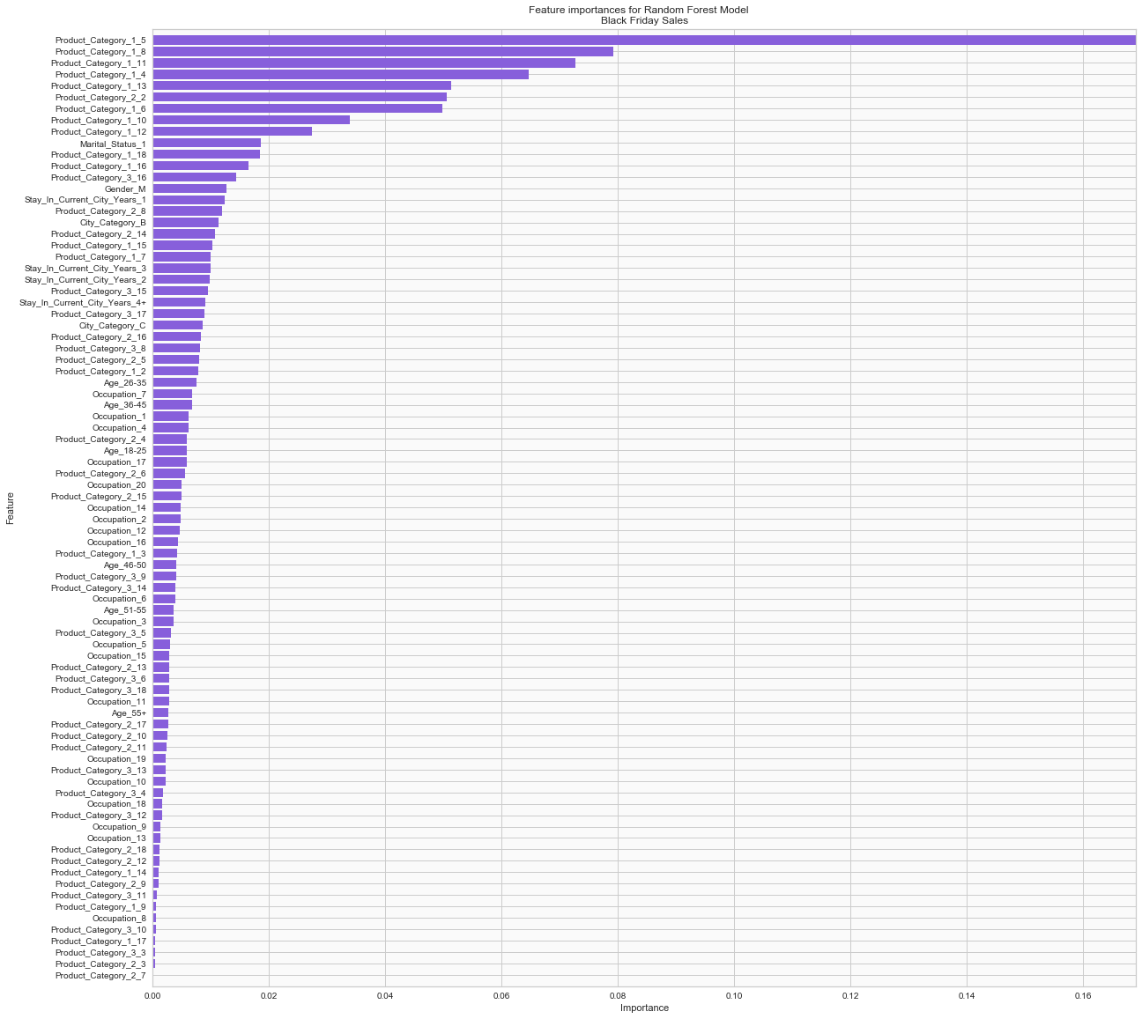
Recommendation for the Client
In the figure, ‘Product_Category_1_5’ has higher importance. ‘Product_Category_1_8’, ‘Product_Category_1_11’, ‘Product_Category_1_4’ could also be recommended.

